Slide 1
Improve your surfing skills
or
How to ride the waves of positive washback
Rachel Appleby, ILSB17

Slide 2
Getting started ...
Notes:
Teach GE ? BE? Kids? 1:1? Exams?
Any pref / enjoy?
Me and HU cit … WHY??

Slide 3
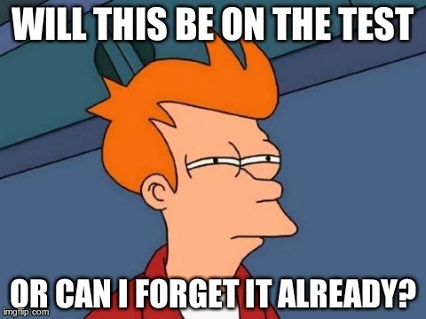
Familiar?

Slide 4
“exams”: What words come to mind?
exams!

Slide 5
Recent reading …

Slide 6
Shock story 1
9 May 2017: Sats exam for 10-11 year olds
…
‘terminology-itis’
There is no evidence whatsoever that teaching kids things like subordinate clauses benefits their writing
MICHAEL ROSEN
www.theguardian.com/education/2017/may/09/fronted-adverbials-sats-grammar-test-primary

Slide 7
Shock story 2
NUT Report, 2015
[the current exam system]
… does not foster the skills and talents that are needed in higher education or in employment or the attributes that will be valued in future citizens.
‘Exam factories?
The impact of accountability measures on children and young people’
www.teachers.org.uk/files/exam-factories.pdf

Slide 8
Shock story 3
'High-stakes' testing harming teaching and learning in primary schools
Assessment is closely linked to accountability […] results used to hold schools and teachers to account
[…] the high stakes system can negatively impact teaching and learning, leading to narrowing of the curriculum and ‘teaching to the test’, as well as affecting teacher and pupil wellbeing.
www.parliament.uk/business/committees/committees-a-z/commons-select/education-committee/news-parliament-2015/primary-assessment-report-published-16-17/
Notes:
OFSTED… school rankings,
Ts’ jobs at stake etc
PRESSURE!!

Slide 9
Shock story 4
Washback - the Effect of Assessment on Teaching & Learning
The fun has gone out of teaching …
… hectic … unmanageable
… overload … never-ending
JENNI BEDFORD
www.researchgate.net/publication/242692354_Washback_-_the_Effect_of_Assessment_on_ESOL_Teaching_and_Learning

Slide 10
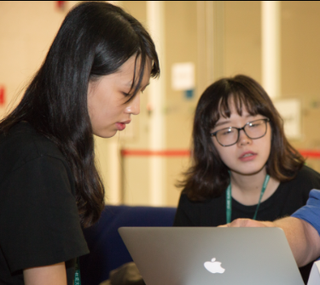
Shock story 5
Teaching IELTS to groups of Chinese students in the UK
Please can we just do practice tests?
[freelance colleague]

Slide 11
Shock story 6
Blogpost, Theodora Papp
I have people come to me asking for lessons, and their exact words are ‘I want to get the B2 certificate’ NOT ‘I want to learn English’.
https://theodorapap.blogspot.hu

Slide 12
Shock story 7
Colleagues / friends in ELT / & in Hungary ...
I mark leniently. My students know that. But I don’t want to be responsible for them not being able to apply for a scholarship, or continue their studies.
[University colleague]

Slide 13
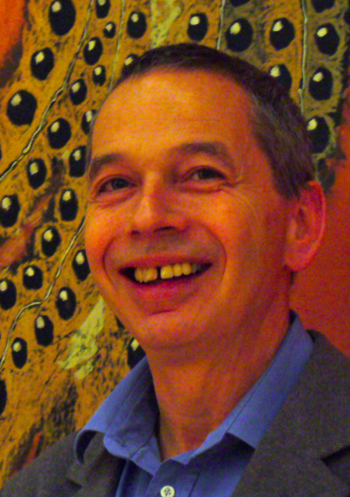
…. and
Frank Furedi (aka Füredi Ferenc) – on Outcomes
When the end acquires such significance the means becomes subordinated to it.
via Harmer 1/6/17 ILSB17, via Thornbury, via THE 2012
www.timeshighereducation.co.uk/story.asp?storycode=421958

Slide 14
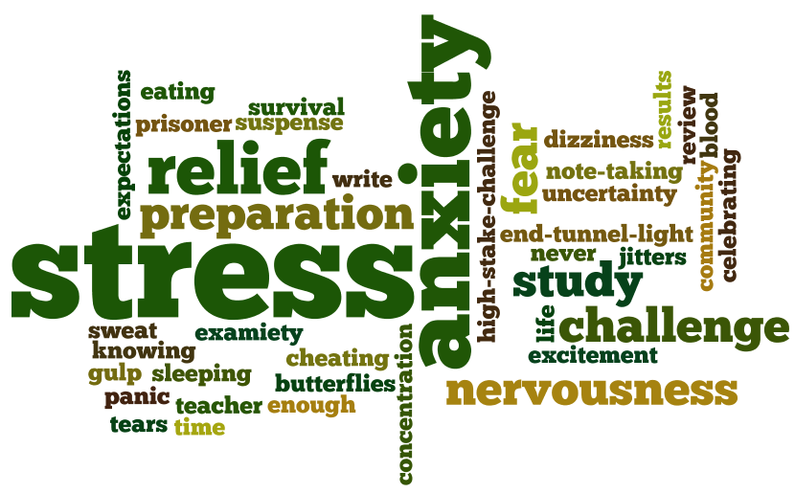
What students say (+/- 20)

Slide 15
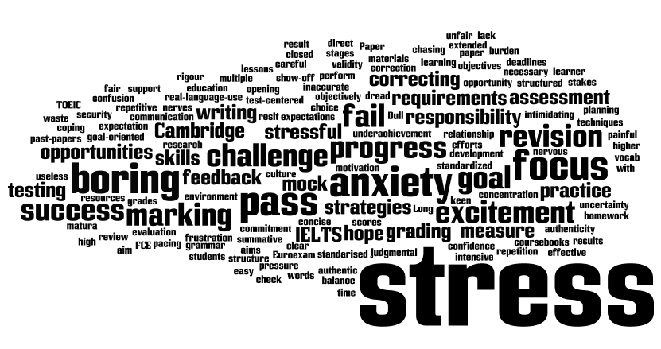
What teachers say (+/- 50)

Slide 16
Terminology
Washback:
the influence of testing on teaching and learning
* see handout for many more definitions and subtleties
Kathleen Bailey, (1996). ‘Working for washback: a review of the washback concept in language testing’

Slide 17
Positive washback
Students are motivated … to perform well / to achieve learning goals
T / Sts can identify areas which still need work on
T / Sts can set learning objectives
T / Sts can keep track of progress
When classroom activities support real-life learning, as well as test success
Based on: Kathleen Bailey, (1996). ‘Working for washback: a review of the washback concept in language testing’

Slide 18
Negative washback
Teachers “teach to the test”
Teachers ignore input not relevant to test
Students only study when there is a test
There is no sync between what is taught and what is performed
Over-test-familiarity and practice: focus on passing the test, not learning subject
Curriculum driven by assessment: high-stakes testing
Based on: Kathleen Bailey, (1996). ‘Working for washback: a review of the washback concept in language testing’

Slide 19
Washback – 3 dimensions
Participants (teachers / learners)
Products (course materials)
Processes (what happens in the classroom)
Based on: Kathleen Bailey, (1996). ‘Working for washback: a review of the washback concept in language testing’

Slide 20
Effects on the learner
Find 1 positive, 1 negative, 1 – ?? (could be both)
practising
studying
conversation practice
reading widely
listening widely
using test-taking strategies
doing extra test-prep courses
requesting guidance / FB on performance
requesting extra test prep courses or tutorials
skip classes to study for test
Based on: Kathleen Bailey, (1996). ‘Working for washback: a review of the washback concept in language testing’

Slide 21
Outline
more awareness of what’s at stake in test choice
how we can address these issues
communicative exam tasks, & what they test
ideas for how to prepare students with meaningful activities > leading to > exam success
&
ensuring we are also preparing students for ...
further study
employment, +/or
contributing to society

Slide 22
Key issues to address
Grammar – for a meaningful purpose
Exam tasks which reflect what we do in life!
Meaningful content – English for study / work / life
The ‘means’ of achieving success
Notes:
Terminology / skills & talents / high-stakes focus; accountability / lack of relevance / no fun!

Slide 23
Key issues to address (1/4)
Grammar * e.g.
“No smoking” vs. “ Please don’t smoke”
http://michaelrosenblog.blogspot.hu
* Relevant for sentence transformation exercises?

Slide 24
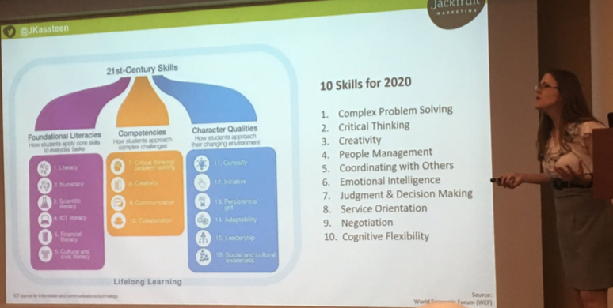
Key issues to address (2/4)
Life, e.g. 21st Century Skills
including:
complex problem solving
critical thinking
co-ordinating with others
emotional intelligence
etc.
JACQUELINE KASSTEEN (#eaquals2017Riga) @JKassteen

Slide 25
Key issues to address (3/4)
Meaningful content, i.e. ensuring we are also preparing students for ...
further study
employment, +/or
contributing to society

Slide 26
Key issues to address (4/4)
The “means” – Frank Furedi on Outcomes
Ensuring classroom exam preparation / activities are relevant and valuable in themselves, as well as for achieving success

Slide 27
What makes a good test / exam?
focuses on a single skill
measures the performance of doing sth through language
uses a task-based approach
defines and limits criteria [criterion-referenced; using language to communicate meanings]
reflects and encourages good classroom practice
KEITH MORROW
Notes:
single skill (i.e. don’t mix reading &writing)
measures the perf [e.g. use CEFR can-do ]
TBL, ie sts carry out a task [e.g. neg’g meaning)
defines +limits crit. [crit-ref’d; i.e. how well st can use lang to comm'te meanings]
good c’rm practice [ = spec ref. washback]

Slide 28
... And if an exam is good, ...
students enjoy the tasks in their own right
the tasks reflect real-world language needs
the exam provides good teaching material
“… creating an exam for teachers, by teachers”
JIM SCRIVENER

Slide 29
Euroexam – sample speaking item
Euroexam Level B2 – SPEAKING – Transactional Dialogues, Task Three
You have to arrange a meeting to discuss something with a colleague. Suggest a meeting tomorrow at 3pm, in room 671.
You are in a hospital and are looking for the x-ray department. Stop a nurse in the corridor and ask for directions.
You have had a drink at a café. You are in a hurry to leave. Ask the waiter for the bill.
Notes:
Interlocutor: Actually, I’m busy tomorrow afternoon. What about 10 o’clock tomorrow morning instead?
Interlocutor: I’m afraid it’ll be a few minutes, we’re rather busy.
Interlocutor: Yes. You need to go down to the end of the corridor, turn left and then left again. It’s the first door on the right. Shall I ask someone to take you there?

Slide 30
Euroexam – sample speaking item
Euroexam Level B2 – SPEAKING – Transactional Dialogues, Task Three
You have to arrange a meeting to discuss something with a colleague. Suggest a meeting tomorrow at 3pm, in room 671.
A What language / skills is this task testing?
B What activities could you do in the classroom to help prepare students for this?

Slide 31
Euroexam – sample speaking item
Euroexam Level B2 – SPEAKING – Transactional Dialogues, Task Three
You have to arrange a meeting to discuss something with a colleague. Suggest a meeting tomorrow at 3pm, in room 671.
A What language / skills is this task testing?
Ability to identify the situation (in/formal)
… to say something appropriate
… to respond (very briefly) to interlocuter’s comment
Familiarity with everyday English in typical settings
Ability to solve a small problem quickly and simply
Notes:
MARKING CRITERIA:
Range & Accuracy; Fluency & Coherence; Pronunciation; Communication strategies

Slide 32
Euroexam – sample speaking item
Euroexam Level B2 – SPEAKING – Transactional Dialogues, Task Three
You have to arrange a meeting to discuss something with a colleague. Suggest a meeting tomorrow at 3pm, in room 671.
B What activities could you do in the classroom to help prepare students for this?
Audio text: Who are the speakers? Where are they?
Rewrite conversation – more or less formal
Choose a picture with 2 people. Write a 5-line dialogue; swap / mix up / match / compare / etc.
Give just one side of dialogue; students write other side
Handout 3 x 3-line dialogues, jumbled. Students group, & order.
Look at the 3-line dialogues: underline stressed words

Slide 33
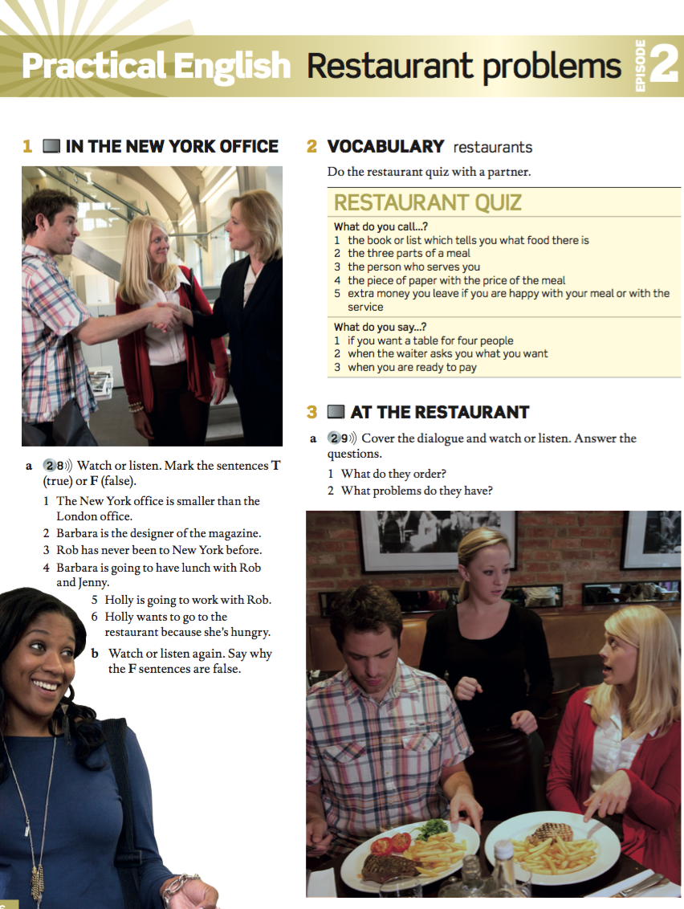
Exam preparation with a coursebook?
OUP English File 3rd edition: Pre-intermediate (2012)

Slide 34
Exam preparation with a coursebook?
Waitress Are you ready to order?
Jenny Yes, please.
W: Can I get you something to start with?
Jenny No, thank you. I’d like the tuna with a salad.
W: And for you, sir?
Rob I’ll have the steak, please.
W: Would you like that with fries, or a baked potato?
Rob Fries, please.
W: How would you like your steak?
Rob Well done.
OUP English File 3rd edition: Pre-intermediate (2012)

Slide 35
Exam preparation with a coursebook?
[…]
W: The tuna for you ma’am, and the steak for you, sir.
Jenny I’m sorry, but I asked for a salad, not fries.
W: No problem. I’ll change it.
Rob Excuse me.
W: Yes, sir?
Rob Sorry, I asked for my steak well done and this is rare.
W: I’m really sorry. I’ll take it back to the kitchen.
OUP English File 3rd edition: Pre-intermediate (2012)

Slide 36
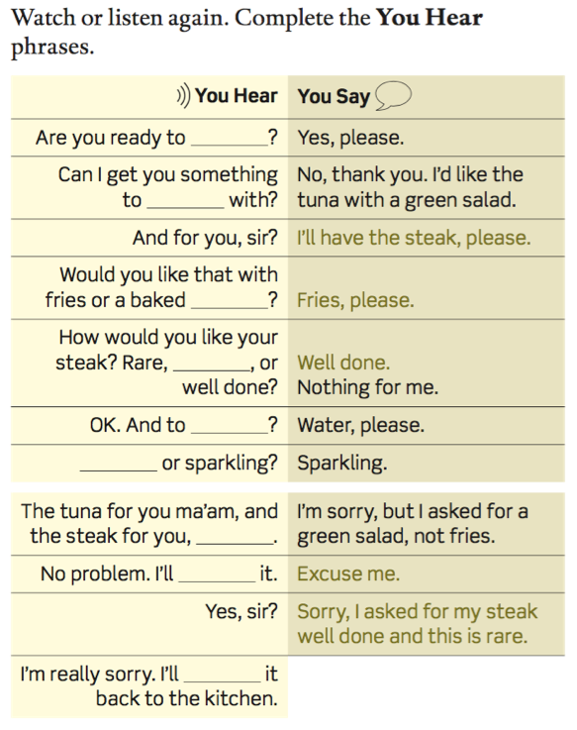
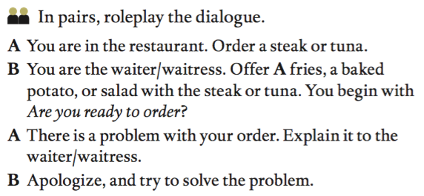
Exam preparation with a coursebook?
OUP English File 3rd edition: Pre-intermediate (2012)

Slide 37
Euroexam – sample tasks
Look at one of the other sample tasks on the handout:
Speaking: Picture Story (B2)
or
Listening: Making Notes (B1)
A What language / skills is this task testing?
B What activities could you do in the classroom to help prepare students for this?

Slide 38
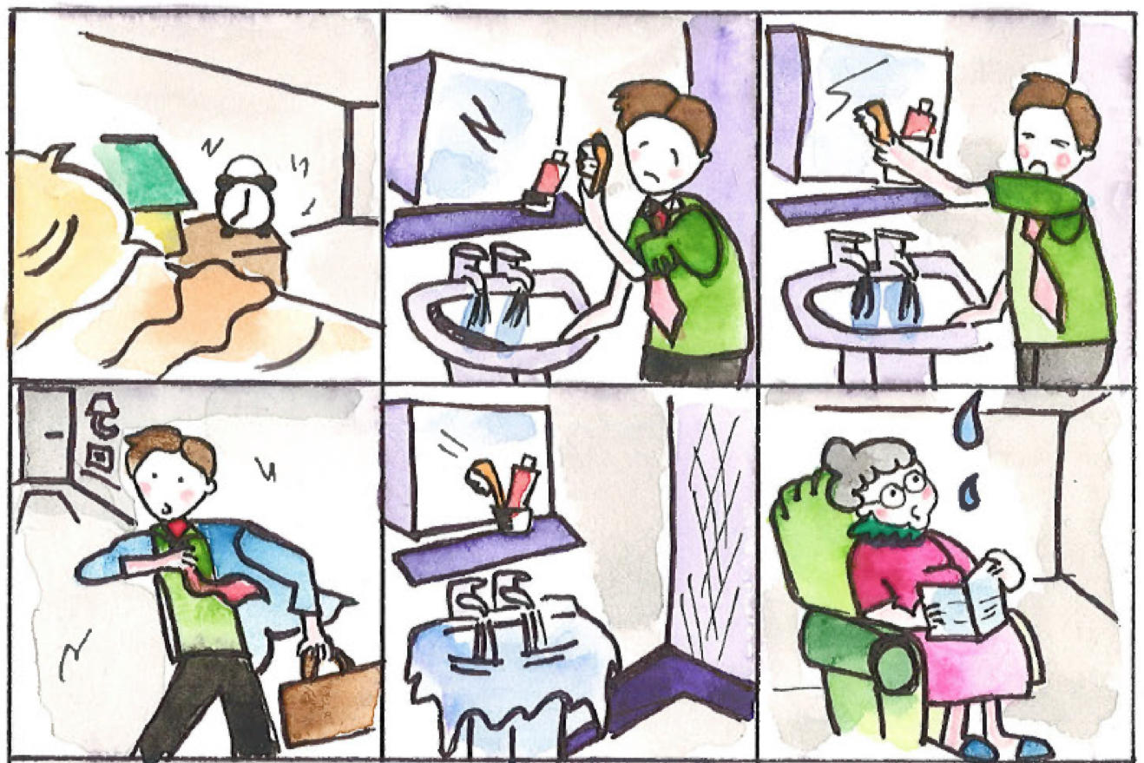
Euroexam – sample speaking item
Euroexam Level B2 – SPEAKING – Picture Story, Task Two
The story starts like this: “As usual on Mondays, Tim’s alarm clock went off at 7 o’clock.”
(+ 6 more pictures, not included here)

Slide 39
Euroexam – sample speaking item
Euroexam Level B2 – SPEAKING – Picture Story, Task Two
The story starts like this: “As usual on Mondays, Tim’s alarm clock went off at 7 o’clock.”
A What language / skills is this task testing?
B What activities could you do in the classroom to help prepare students for this?

Slide 40
Euroexam – sample speaking item
Euroexam Level B2 – SPEAKING – Picture Story, Task Two
The story starts like this: “As usual on Mondays, Tim’s alarm clock went off at 7 o’clock.”
A What language / skills is this task testing?
Ability to produce continuous speech with a cohesive, logical story
Use of appropriate past tenses
Use of linking words
Use of descriptive language
NB: Students should not read from notes; they should focus on the story, not individual pictures

Slide 41
Euroexam – sample speaking item
Euroexam Level B2 – SPEAKING – Picture Story, Task Two
B Activities to help prepare students:
Use any (series of) pictures; encourage students to invent a story
Before / after stories (1 picture); compare
Give students 5 words: make a story
Round-the-class stories
Groups get set of linking words: in turn, add to story & use word
‘consequences’: group stories, line by line
Re-order jumbled stories

Slide 42
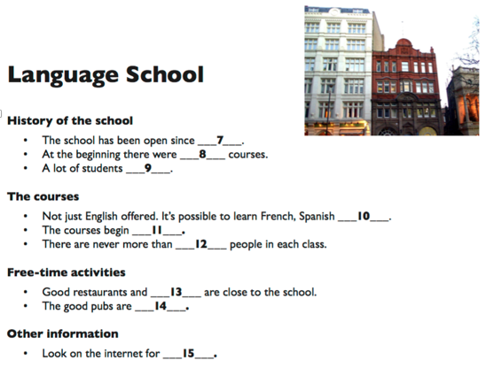
Euroexam – sample listening item
Euroexam Level B1 – LISTENING – Making Notes, Task Two

Slide 43
Euroexam – sample listening item
Euroexam Level B1 – LISTENING – Making Notes, Task Two
A What language / skills is this task testing?
Listening for key information
Being tolerant of not understanding every word

Slide 44
Euroexam – sample listening item
Euroexam Level B1 – LISTENING – Making Notes, Task Two
B Activities to help prepare students:
Hand out text title +/or picture: students predict content
Sts guess missing information; listen to check
Discuss abbreviations, e.g. information, about, including, etc.
Underline words probably stressed in text; listen to compare
Hand out complete text: sts underline key info; compare
www.euroexam.com/exam-preparation-classroom-activities

Slide 45
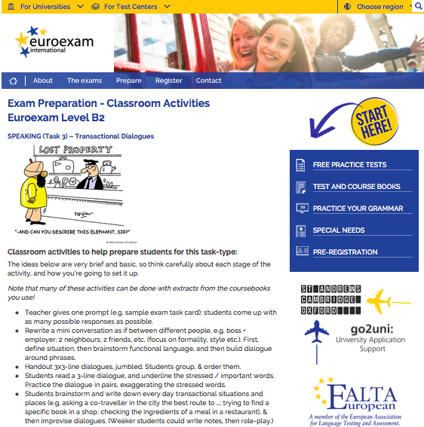
Exam prep – classroom activities
www.euroexam.com/exam-preparation-classroom-activities

Slide 46
Exam preparation with a coursebook
https://elt.oup.com/events/cz/maturita_solutions_day?cc=cz&selLanguage=cs&mode=hub&WT.ac=cz_solutions_day_event_apr_2017 Praha 7/6, Brno 13/6

Slide 47
To summarise:
Focus on tasks which reflect real-world language needs
Use coursebook material to support exam prep
Prepare students for
further study
work
contributing to society
Students will enjoy the tasks in their own right!
Notes:
Terminology / skills & talents / high-stakes focus; accountability / lack of relevance / no fun!

Slide 48
To summarise,
Notes:
Terminology / skills & talents / high-stakes focus; accountability / lack of relevance / no fun!

Slide 49
Bibliography / References
Bachman, L. & A. Palmer. (1996). Language Testing in Practice. Oxford: Oxford University Press https://octovany.files.wordpress.com/2013/12/language-testing-in-practice-bachman-palmer.pdf
Bailey, K.M. (1996). ‘Working for washback: a review of the washback concept in language testing’: http://ltj.sagepub.com/content/13/3/257
Bedford, J. (2003). ‘Washback – the Effect of Assessment on ESOL Teaching and Learning’: www.researchgate.net/publication/242692354_Washback_-_the_Effect_of_Assessment_on_ESOL_Teaching_and_Learning
Füredi, F. (2012). ‘The Unhappiness Principle’:
www.timeshighereducation.co.uk/story.asp?storycode=421958
Hutchings, M. (2005). ‘Exam factories: The impact of accountability measures in children and young people’: www.teachers.org.uk/files/exam-factories.pdf
Pap, T. (2017). ‘Exams, exams, exams’: https://theodorapap.blogspot.hu
Morrow, K. (1991). ‘Evaluating communicative tests’. In: Anivan, S. (Ed.), Current Developments in Language Testing. RELC, Singapore, pp. 111-118.
Rosen, M. (2017). ‘Battle on the adverbials front: grammar advisers raise worries about Sats tests and teaching’: www.theguardian.com/education/2017/may/09/fronted-adverbials-sats-grammar-test-primary
Rosen, M. (2017). ‘A few notes on what teaching grammar to 9-11 year olds could be like (in my dreams!)’: http://michaelrosenblog.blogspot.hu/2017/05/a-few-notes-on-what-teaching-grammar-to.html?spref=tw%C2%A0
Shawcross, P. (2007). ‘What do we mean by the “washback effect” of testing?’ www.icao.int/icao/en/anb/meetings/ials2/Docs/15.Shawcross.pdf
Taylor, L. (2005). ‘Key concepts in ELT: Washback and impact’. ELTJ, 59/2. Oxford: OUP
Common European Framework of Reference, www.coe.int/t/dg4/linguistic/Source/Framework_EN.pdf
& English File 3rd edition. Pre-Intermediate: Oxendon, Latham-Koenig, Seligson. (2012) OUP.

Slide 50
Improve your surfing skills
Rachel Appleby, ILSB17
rachel.appleby @ euroexam.org
http :// rachelappleby.edublogs.org
@rapple18

